Slide 1
Real or fake? A Comparison Between Scattering Network & Resnet-18
Deng yizhe Huang yifei sun jiaze TAN Haiyi

Slide 2
Outline
Introduction
Feature Extraction & Visualisation
Training
Inference
Conclusion & Future Work

Slide 3
Outline
Introduction
Feature Extraction & Visualisation
Training
Inference
Conclusion & Future Work

Slide 4
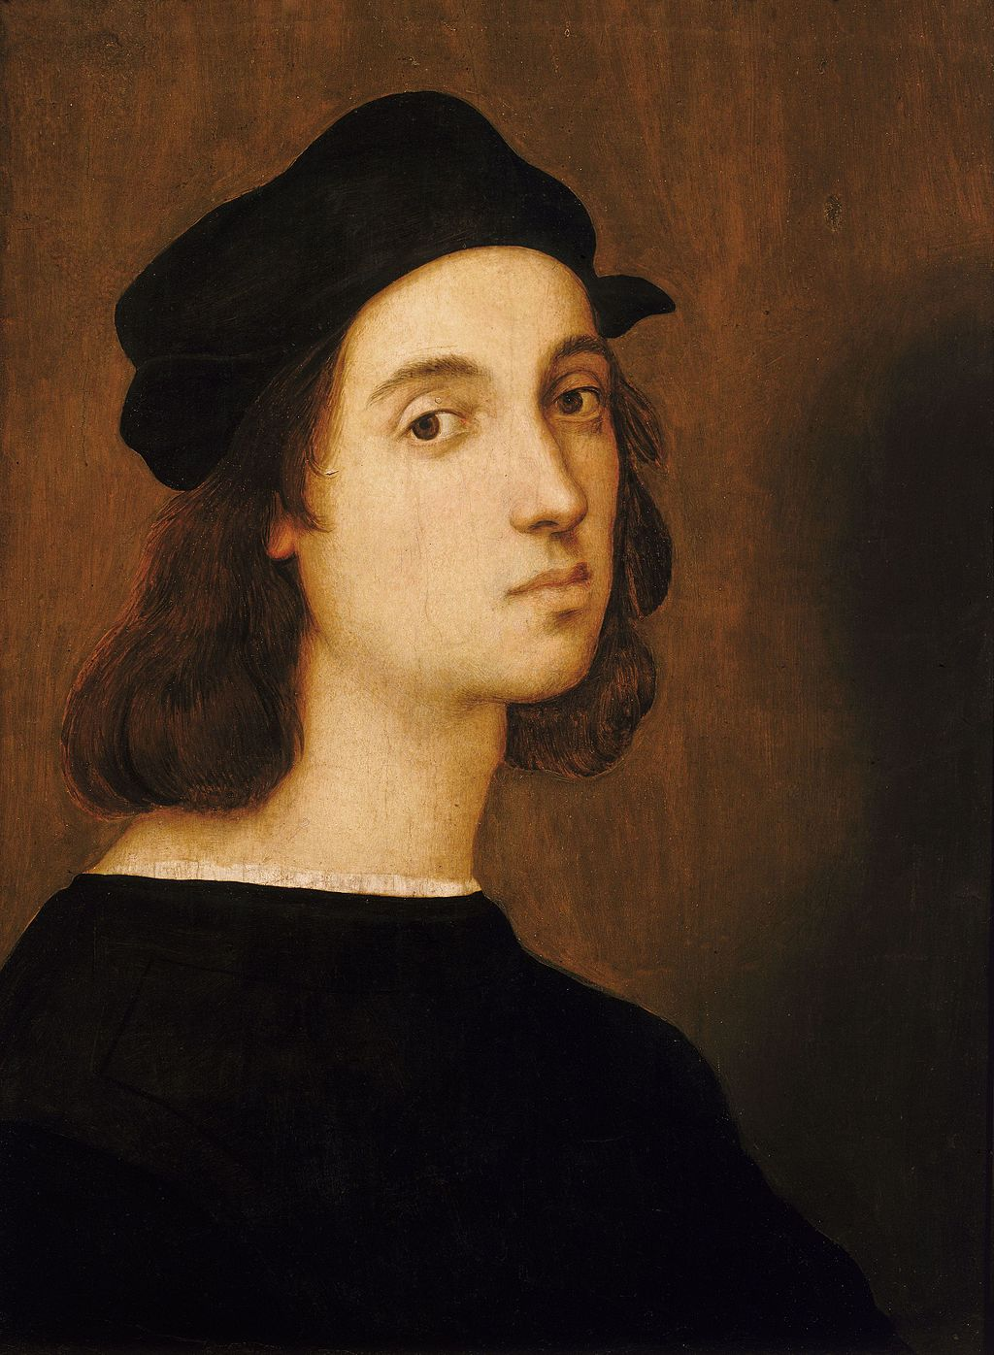
data
28 scanned images of drawings:
12 are attributed to Raphael
9 are NOT attributed to Raphael
7 disputed
Raphael

Slide 5
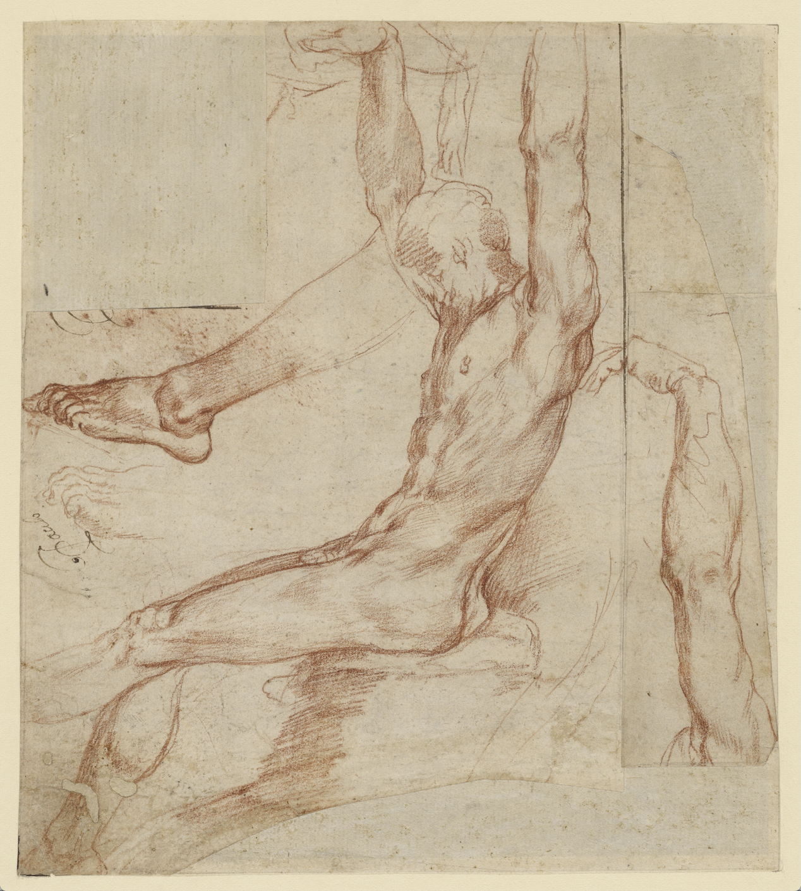
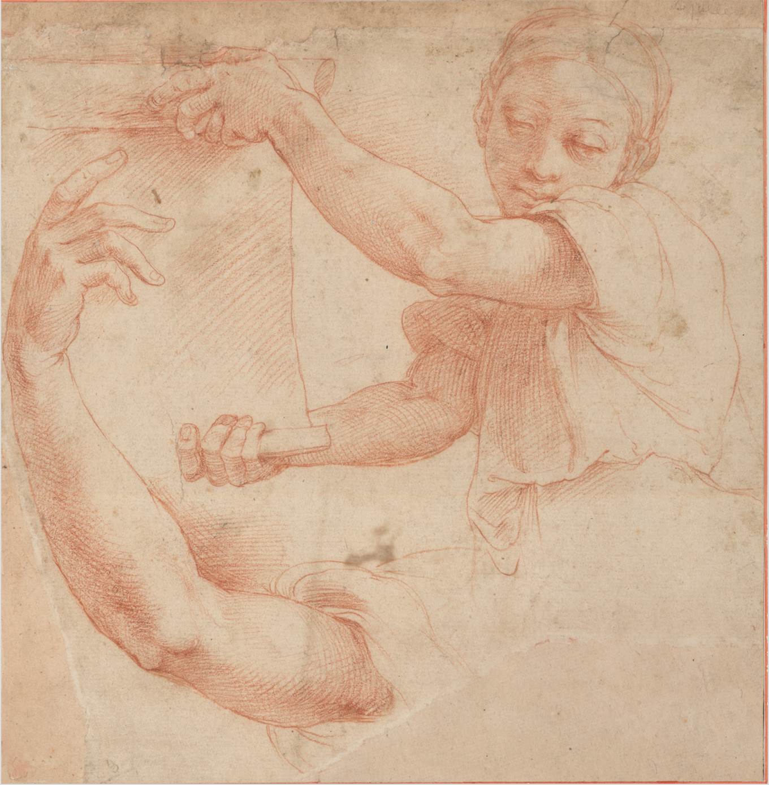
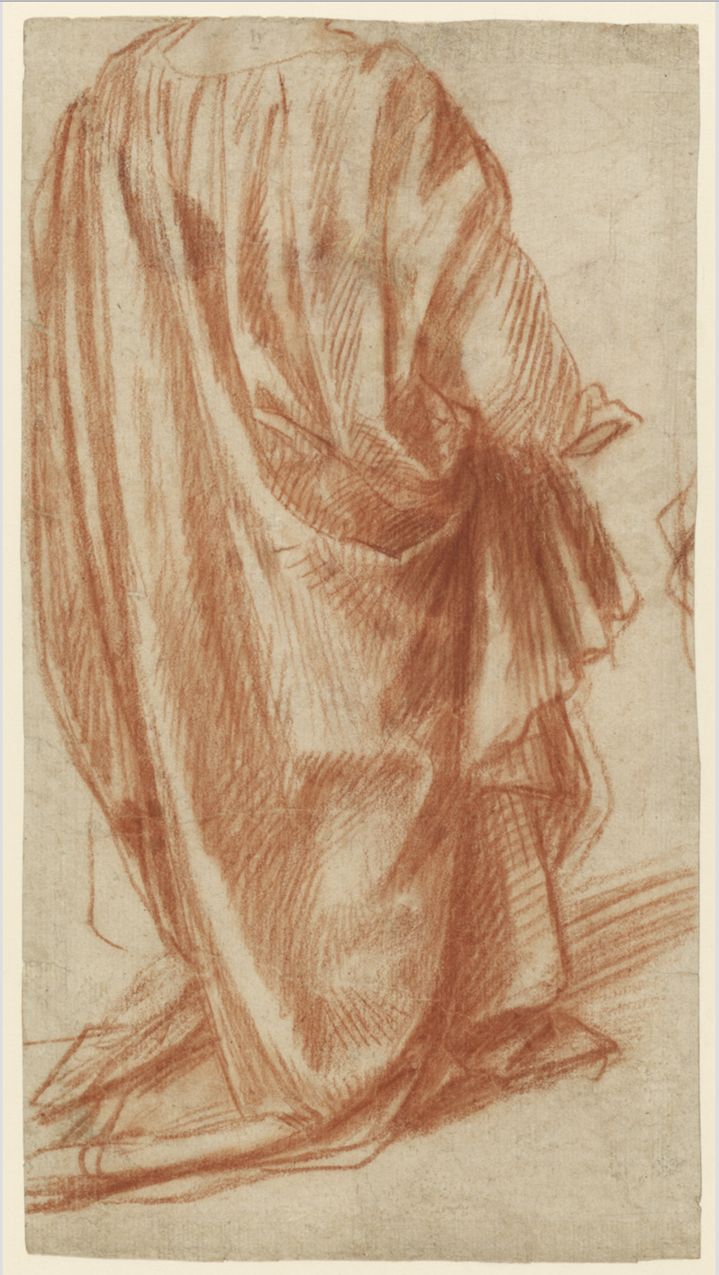
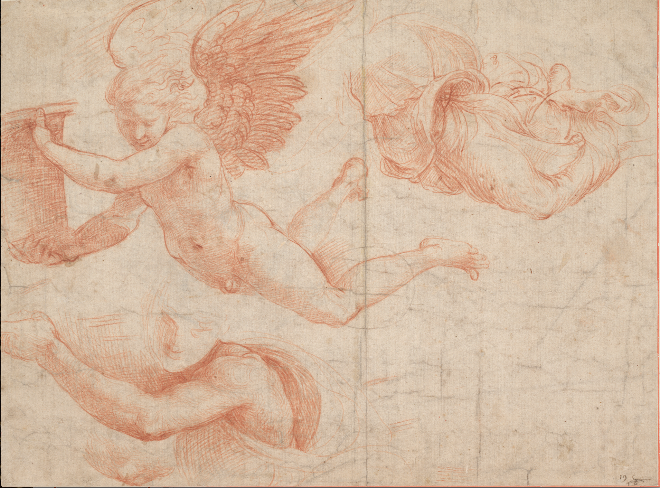
Raphael’s sketches

Slide 6
Objectives
Extract features using Scattering Network and Resnet-18
Visualise these features
Train classifiers on the labelled sketches
Predict the authenticity of the unlabelled sketches

Slide 7
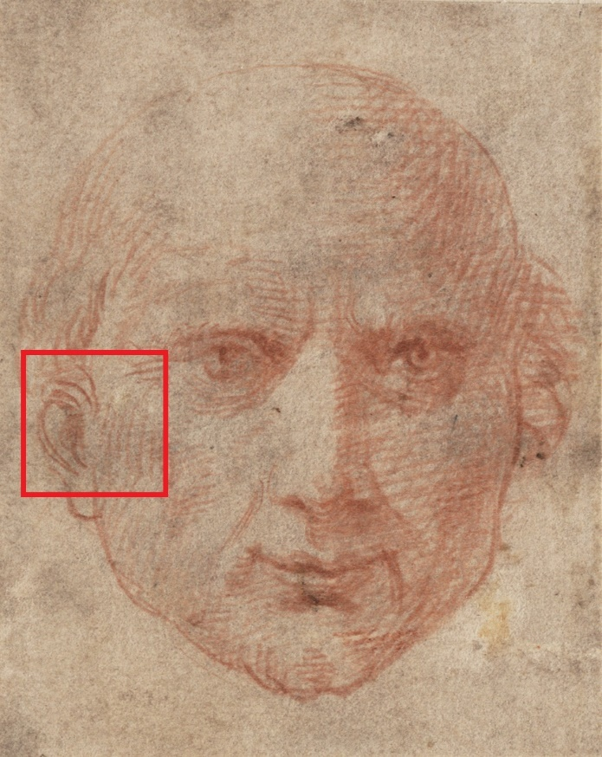
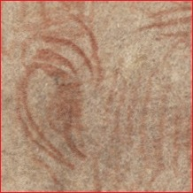
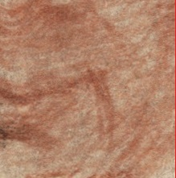
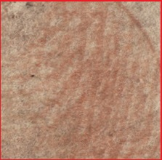
Pre-processing
Data set too small!
Solution: Random Cropping
Size 224x224
200 patches for each image
4200 labelled data points in total

Slide 8
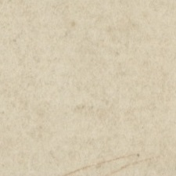
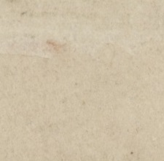
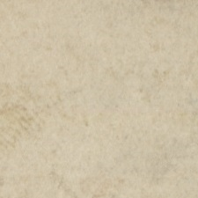
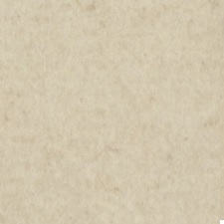
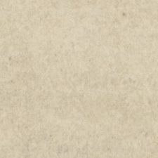
Pre-processing
Remove ‘useless’ patches
For each image:
Randomly crop 400 patches
Compute the variance of pixels
Discard 200 patches with the lowest variances

Slide 9
Outline
Introduction
Feature Extraction & Visualisation
Training
Inference
Conclusion & Future Work

Slide 10
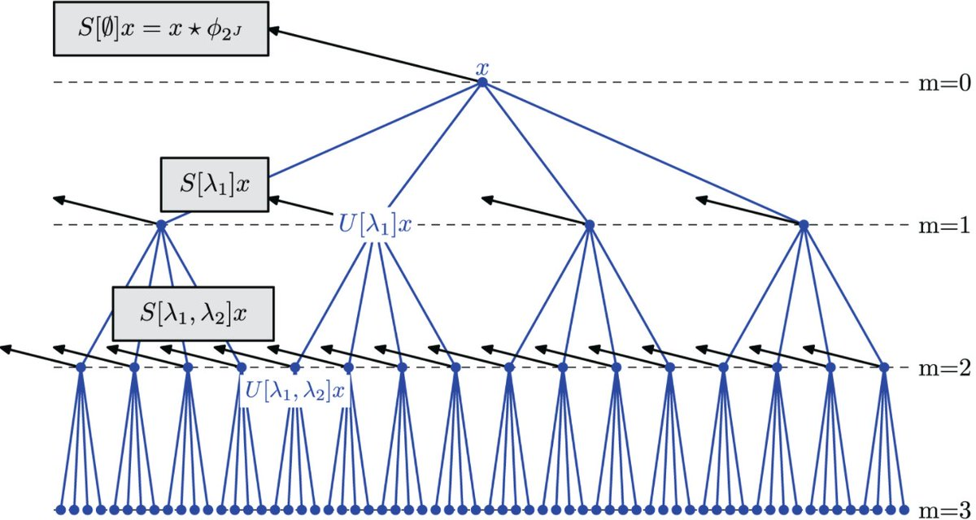
Scattering network
Transform into greyscale
2 layers, 5 scales, 6 orientations
Concatenate the outputs into a single vector of 417 dimensions
Scattering Network (example)

Slide 11
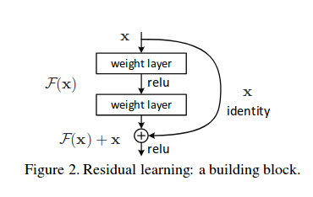
Resnet-18
18 layers
Extract features by removing the last fully-connected layer
The features have 512 dimensions
Residual Network building block

Slide 12
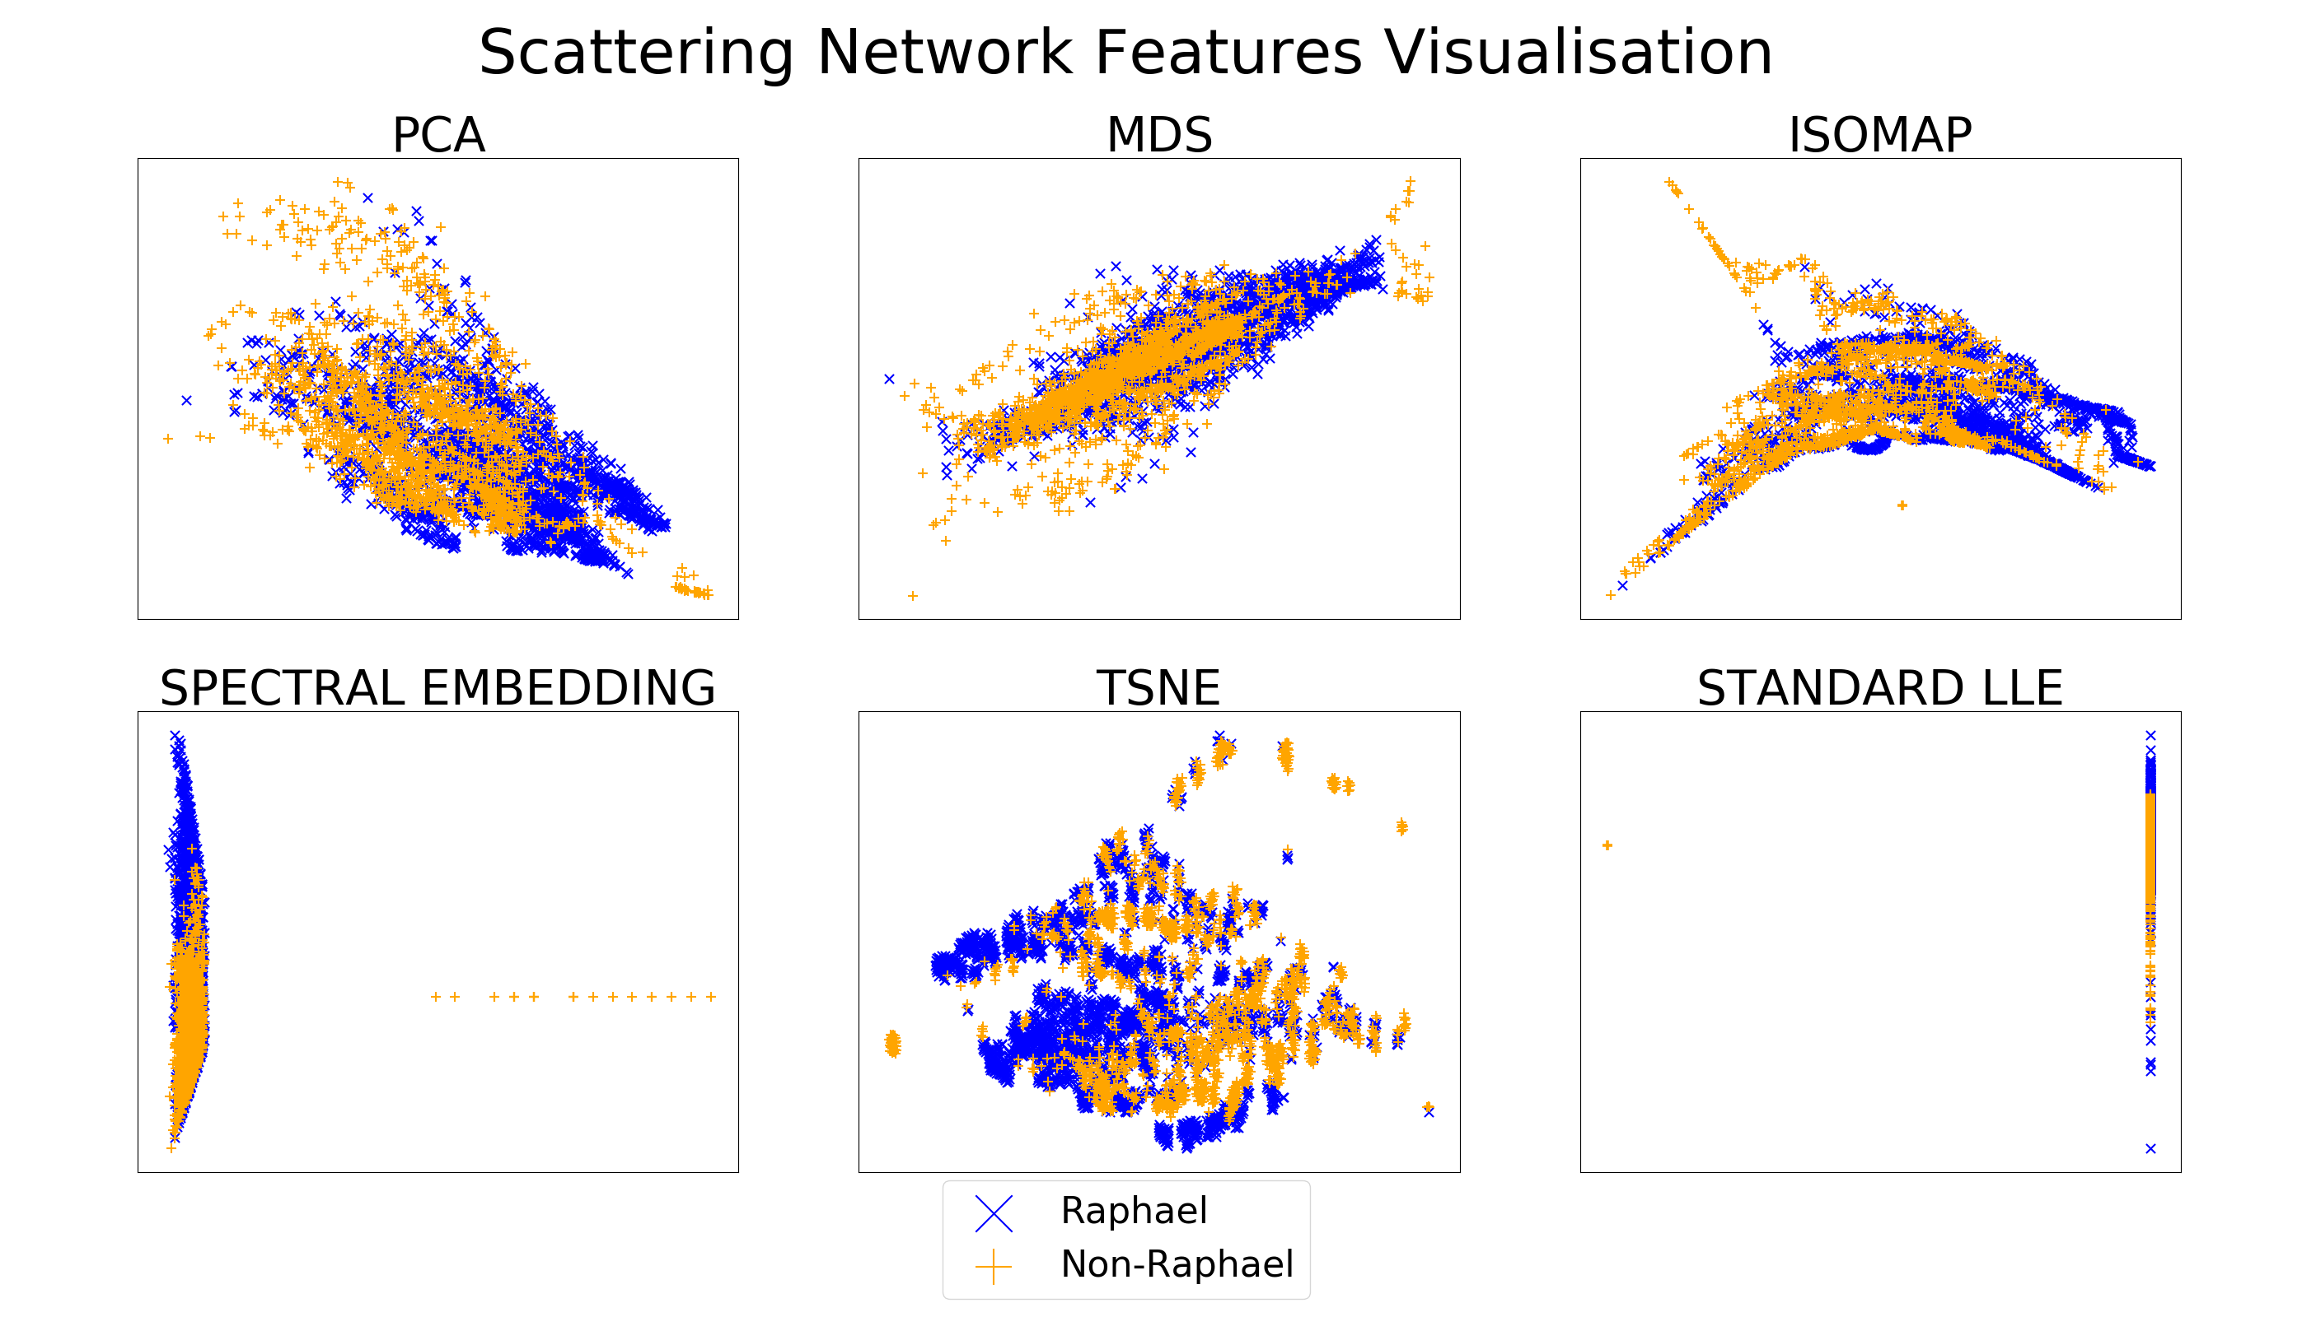
Scattering network

Slide 13
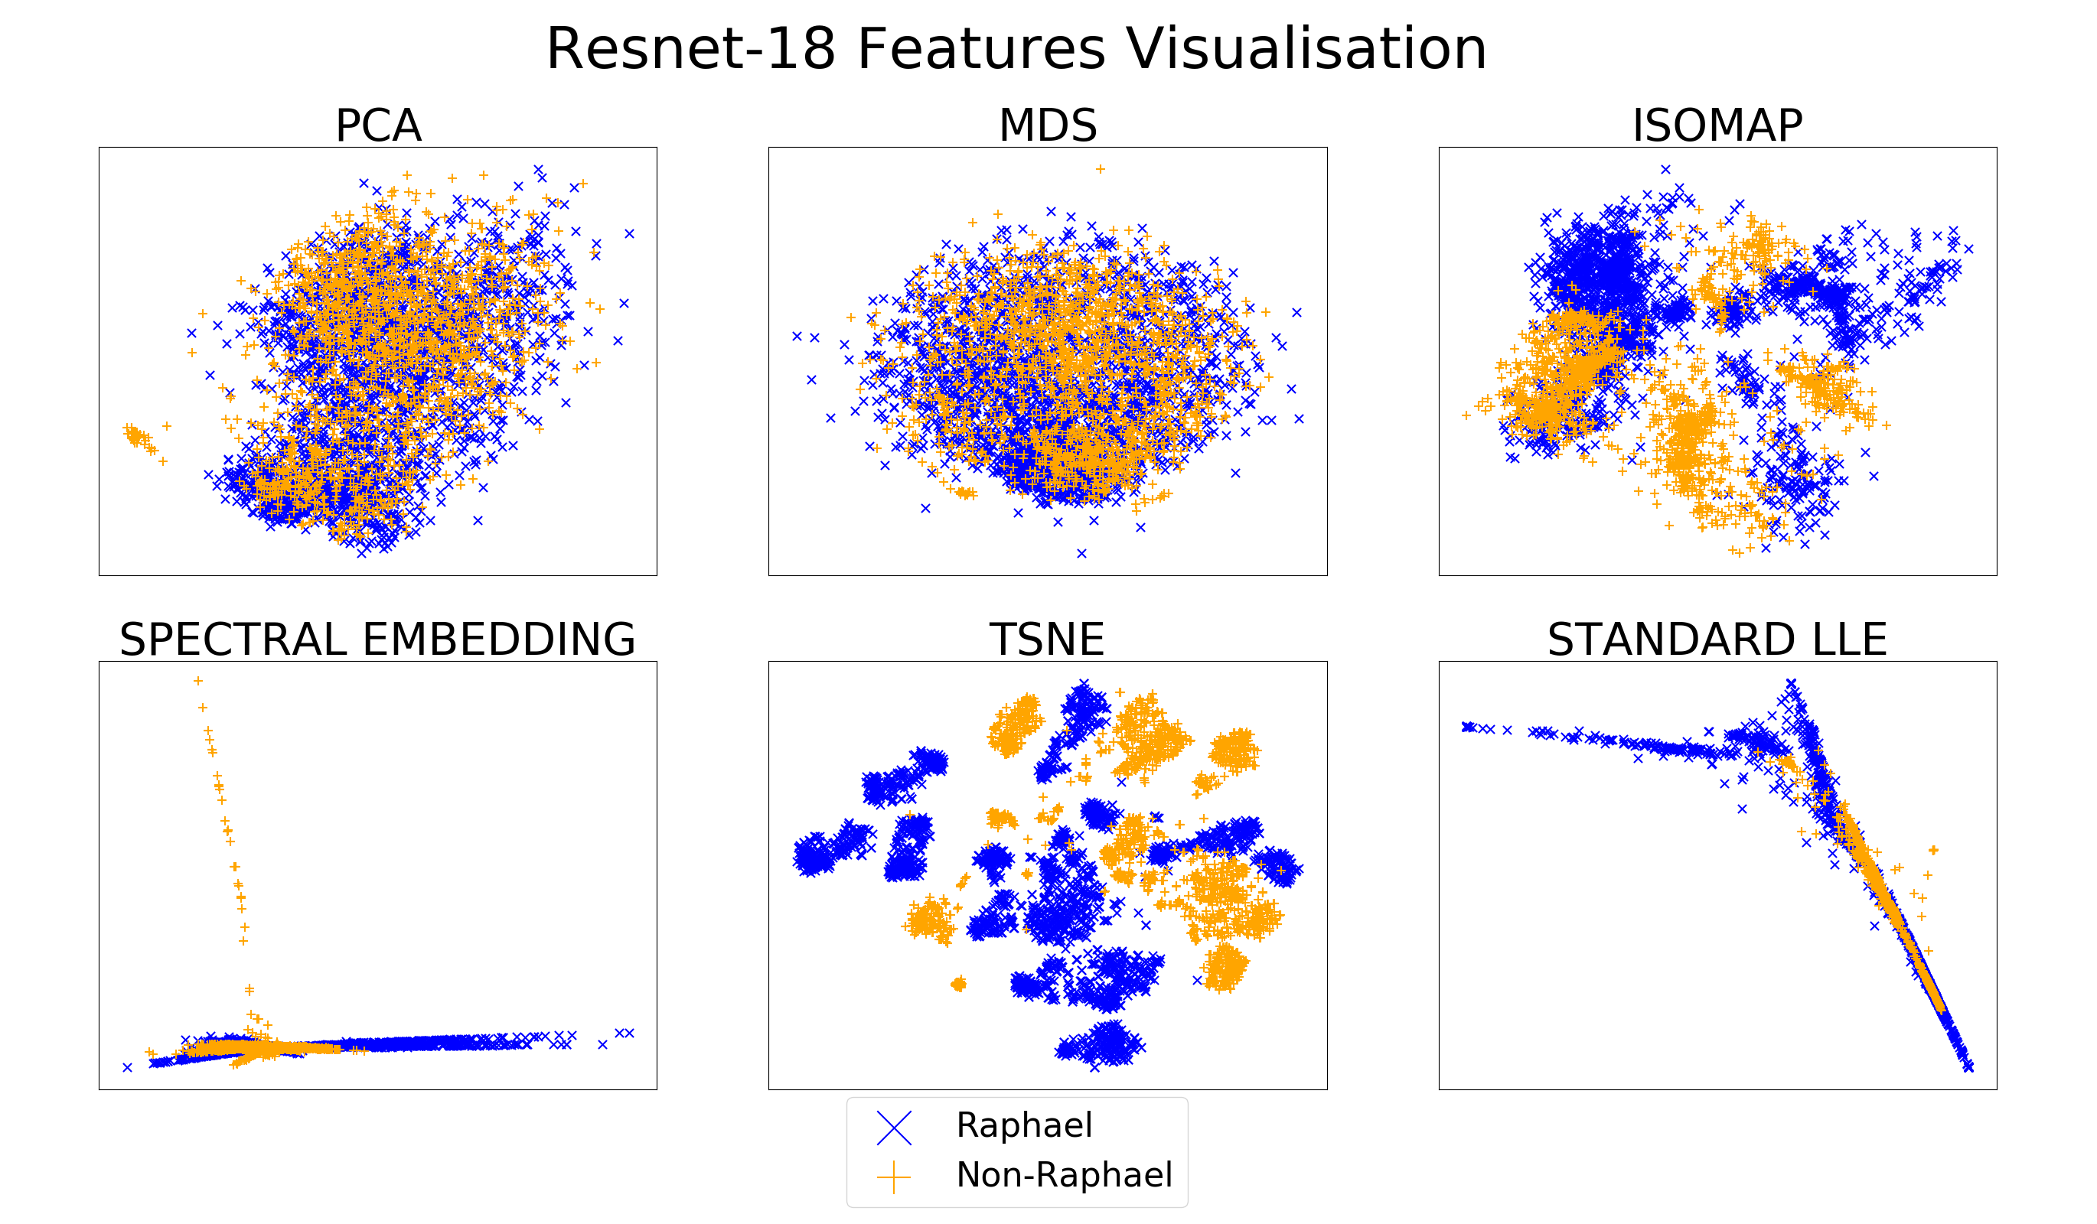
Resnet-18

Slide 14
Outline
Introduction
Feature Extraction & Visualisation
Training
Inference
Conclusion & Future Work

Slide 15
Majority voting & Cross validation
Majority voting:
A drawing’s classification is determined by the majority of its patches.
Leave-one-out-cross-validation:
Train on all but one image (not patches)
Test on that one image by majority voting

Slide 16
Classifiers
Logistic Regression (LR)
K-nearest Neighbour (KNN)
Random Forest (RF)
Support Vector Machine (SVM)

Slide 17
Results
 |  | Classifier
 |  | LR | KNN | RF | SVM
Feature Extraction Method | Resnet-18 | 80.95% | 85.71% | 76.19% | 80.95%
 | Scattering Network | 95.24% | 52.38% | 71.42% | 90.48%
Classification accuracies

Slide 18
Outline
Introduction
Feature Extraction & Visualisation
Training
Inference
Conclusion & Future Work

Slide 19
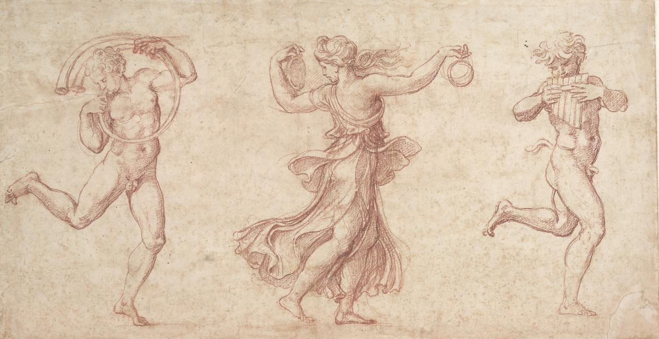
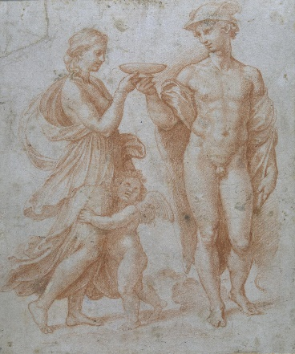
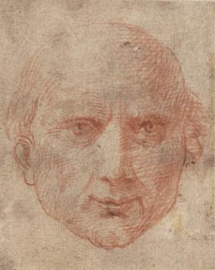
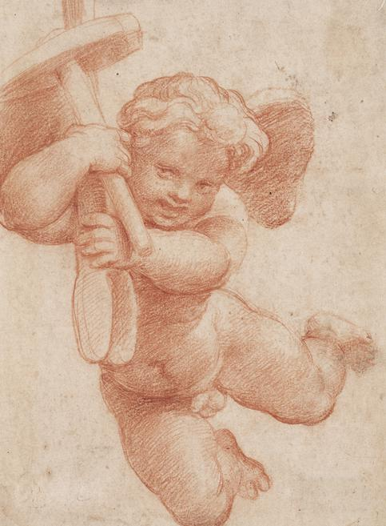
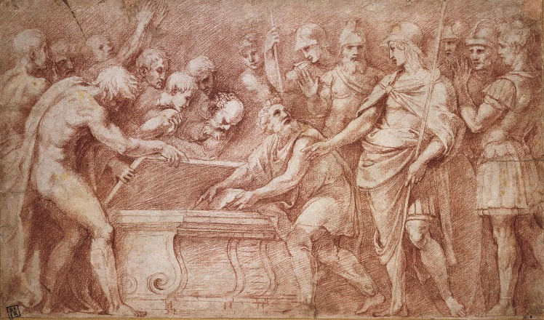
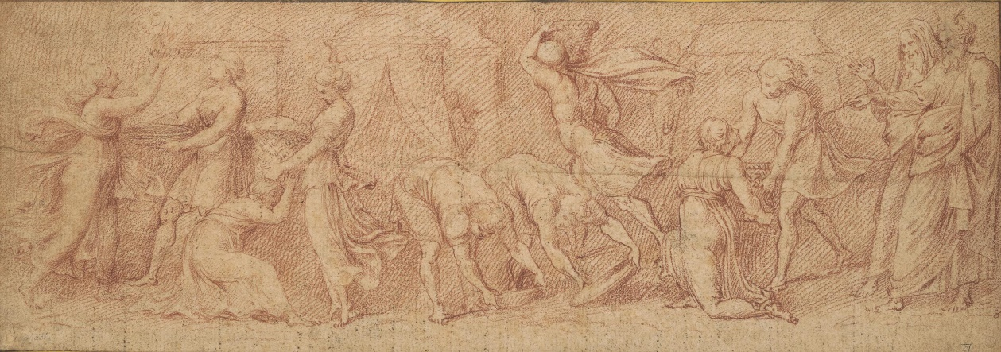
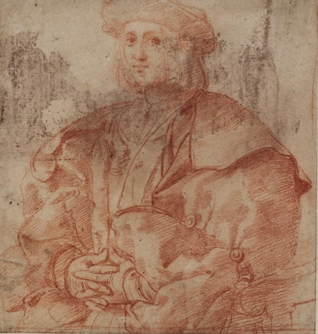
Disputed Drawings
Image 1
Image 10
Image 23
Image 25
Image 7
Image 20
Image 26

Slide 20
Predictions
✓: Raphael
✗: NOT Raphael
 |  | Feature Extraction Method
 |  | Restnet-18 |  |  |  | Scattering Network
Classifier |  | LR | KNN | RF | SVM | LR | KNN | RF | SVM
Image ID | 1 | ✓ | ✓ | ✓ | ✓ | ✓ | ✓ | ✓ | ✓
 | 7 | ✗ | ✗ | ✓ | ✓ | ✓ | ✗ | ✗ | ✓
 | 10 | ✗ | ✗ | ✗ | ✗ | ✗ | ✗ | ✗ | ✗
 | 20 | ✗ | ✗ | ✗ | ✗ | ✓ | ✗ | ✓ | ✓
 | 23 | ✗ | ✓ | ✓ | ✗ | ✓ | ✗ | ✗ | ✓
 | 25 | ✓ | ✓ | ✓ | ✓ | ✓ | ✓ | ✗ | ✓
 | 26 | ✗ | ✓ | ✗ | ✗ | ✓ | ✗ | ✓ | ✓

Slide 21
Prediction: Raphael
Image 1
Image 25

Slide 22
Prediction: Not Raphael
Image 10

Slide 23
Resnet-18: More harsh?
These 2 drawings are classified as Raphael’s by Scattering Network features, but as NOT Raphael’s by Resnet-18 features.
Image 20
Image 26

Slide 24
Outline
Introduction
Feature Extraction & Visualisation
Training
Inference
Conclusion & Future Work

Slide 25
Conclusions
Scattering Network on par with Resnet-18 in terms of extracting useful features
Classification on Resnet-18 features more reliable (stable) than Scattering Network

Slide 26
Future Work
Try different data pre-processing (e.g. cropping) techniques
Improve visualisation results by calibrating certain parameters
Try other classifiers, e.g. boosting, one-layer fully-connected neural network (fine-tuning)

Slide 27
References
J. Bruna, S. Mallat. Invariant Scattering Convolution Networks. arXiv. 2012.
K. He, X. Zhang, S. Ren, J. Sun. Deep Residual Learning for Image Recognition. arXiv. 2015. Retrieved from: https://arxiv.org/pdf/1512.03385.pdf.

Slide 28
Thanks For Listening!

